Slide 1
Topic: Pythagoras
EQ – When do I need to use the Pythagorean Theory?

Slide 2
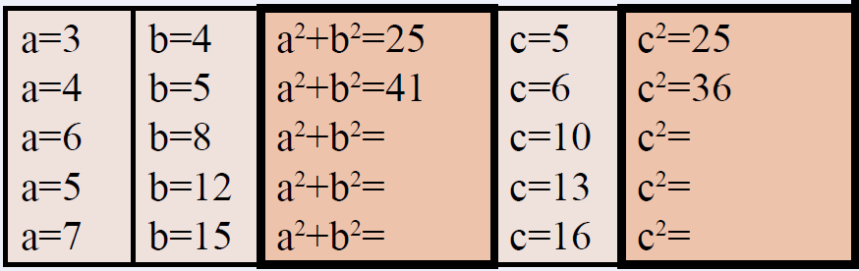
Topic: Pythagoras
EQ – When do I need to use the Pythagorean Theory?
Check : Seating plan
GET YOUR VIVOS
Arrive on time and begin working within 10 mins of the start of lesson AND NO PHONES
Work:
New Unit Cover page- Pythagoras glue in the learning goals
Review Questions: Copy and complete this table on LHS:

Slide 3
Learning Intentions
Students will be able to
- use Pythagoras’ theory to find the length of an unknown side
 | Goal-setting for Year 10 Pythagoras and Trigonometry
Week/s | A | B | C | D
8 and 10 | Chooses (without direction within question) to use algebra in solving a problem requiring the use of Pythagoras’ Theorem to find the missing lengths of the side/s. Diagrammatically represents a complex word problem (including direction and elevation) and applies Pythagoras’ Theorem multiple times to determine an unknown side length | Diagrammatically represents a word problem involving elevations. | Diagrammatically represents a word problem and applies Pythagoras’ Theorem to determine an unknown side length of a right-angled triangle. | Applies Pythagoras’ Theorem to determine an unknown side length of a given right-angled triangle.

Slide 4
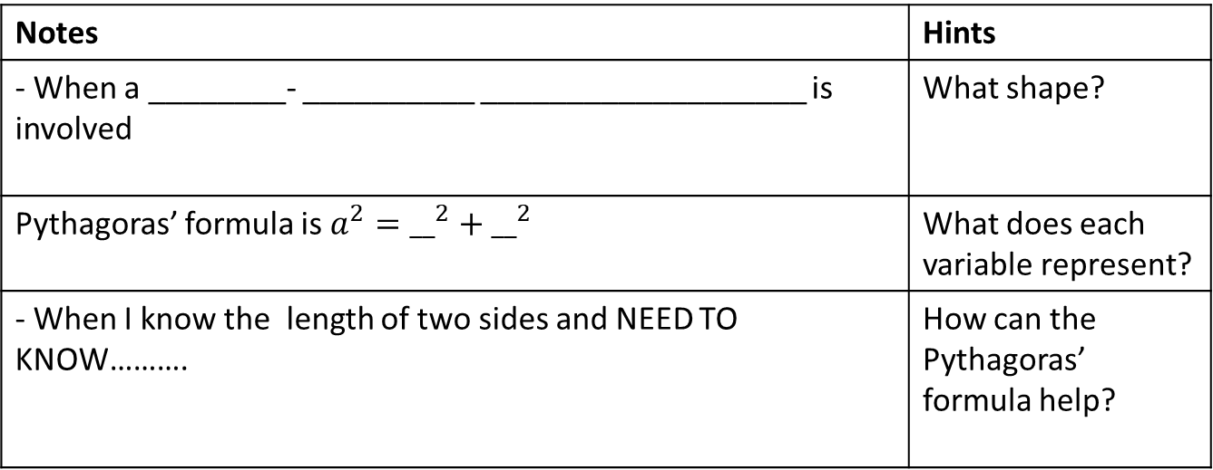
24
7
30
Topic: Statistics
Date:
EQ – When do I need to use the Pythagorean Theory?
When do I need to use the Pythagorean Theorem ?
Notes | Hints
- When a ________- __________ ___________________ is involved | What shape?
Pythagoras’ formula is $a^{2}={__}^{2}+{__}^{2}$ | What does each variable represent?
- When I know the length of two sides and NEED TO KNOW………. | How can the Pythagoras’ formula help?

Slide 5
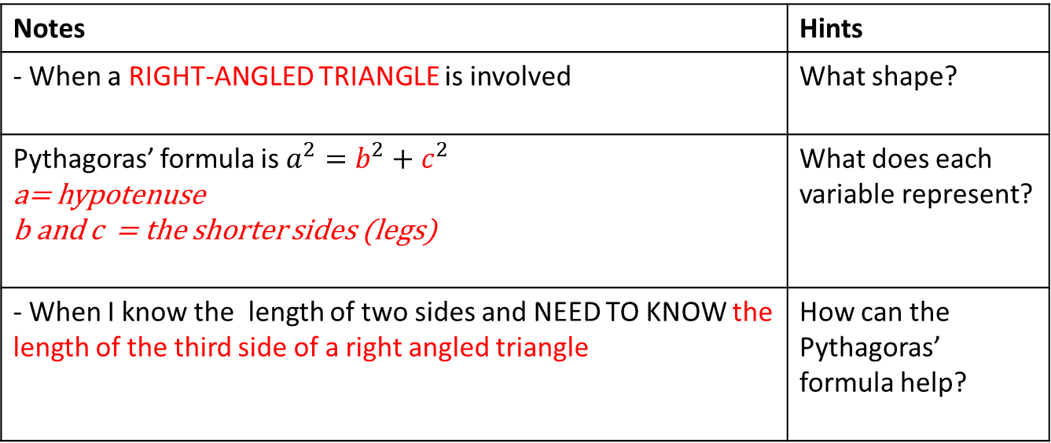
24
7
30
Topic: Statistics
Date:
EQ – When do I need to use the Pythagorean Theory?
When do I need to use the Pythagorean Theorem ?
Notes | Hints
- When a RIGHT-ANGLED TRIANGLE is involved | What shape?
Pythagoras’ formula is $a^{2}=b^{2}+c^{2}$ a= hypotenuse b and c = the shorter sides (legs) | What does each variable represent?
- When I know the length of two sides and NEED TO KNOW the length of the third side of a right angled triangle | How can the Pythagoras’ formula help?

Slide 6
What is the Pythagorean Theorem?
c
a
b
Where a and b are legs and c is the hypotenuse

Slide 7
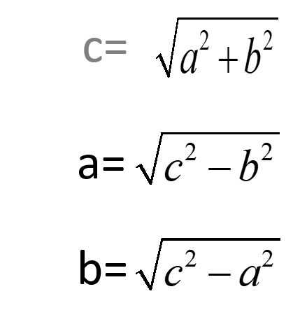
24
7
30
Topic: Statistics
Date:
EQ – When do I need to use the Pythagorean Theory?
Discussion on each of these Pythagoras formulas

Slide 8
EXAMPLES:
a² + b² = c²
15² + 20² = c²
225 + 400 = c²
625 = c²
Looking for length of the hypotenuse
x
15
20

Slide 9
EXAMPLES:
a² + b² = c²
6² + b² = 10²
36 + b² = 100
-36 -36
b² = 64
b = 8
Looking for length of a leg
10
6
x

Slide 10
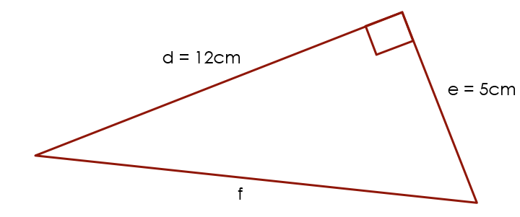

Practice:
D GRADE:
Name the side of the hypotenuse?
Determine the length of the hypotenuse.
Answers
The hypotenuse is side f.
$$f^{2}=d^{2}+e^{2}$$
$$f^{2}={12}^{2}+5^{2}$$
$$f^{2}=144+25$$
$$f^{2}=169$$
$$f=\sqrt{169}$$
$f=13$ cm

Slide 11
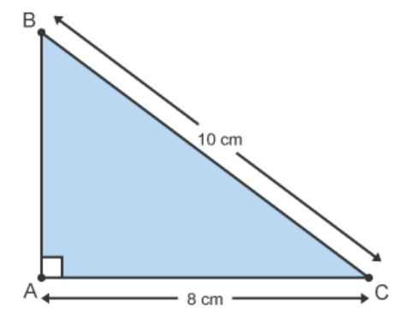
Practice:
D GRADE:
Calculate the length AB.
Answers
The length AB is 6 cm.

Slide 12
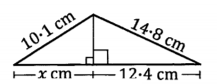
24
7
30
Topic: Statistics
Date:
EQ – When do I need to use the Pythagorean Theory?
JUST ANOTHER ONE OF THE REARRANGED EQUATIONS WITH THE ADDED COMPLEXITY OF 2 COMBINED TRIANGLES. USE ALL OF THE NUMBERS GIVEN TO YOU IN THE Q.
Find the value o$f x$in the diagram below, correct to two decimal places

Slide 13
Practicing Pythagoras worksheet

